Slide 1
Meeting 01/02/2022
Joren Janzing

Slide 2
Content
First glance of the MITgcm data: is there something like an 1940s melt event present?
Hovmoller (very short)

Slide 3
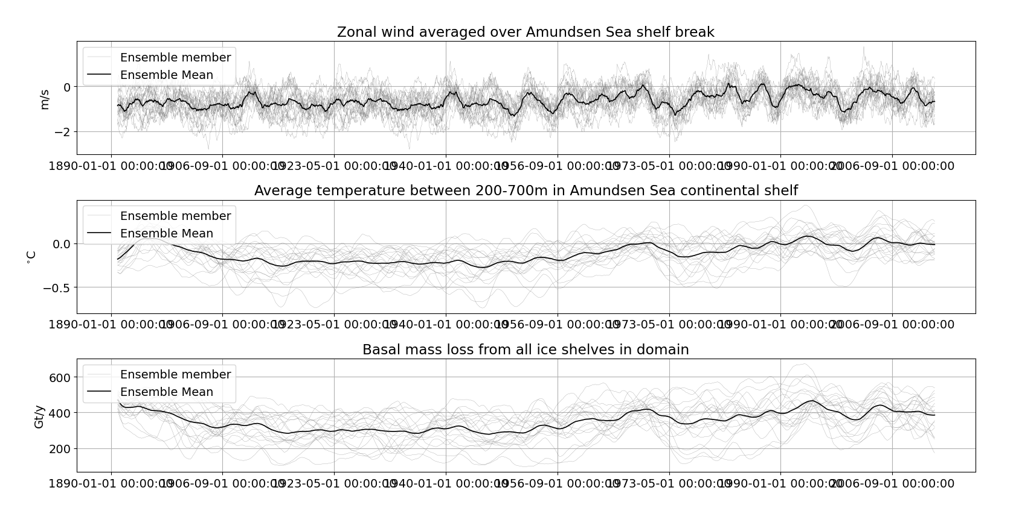

Slide 4
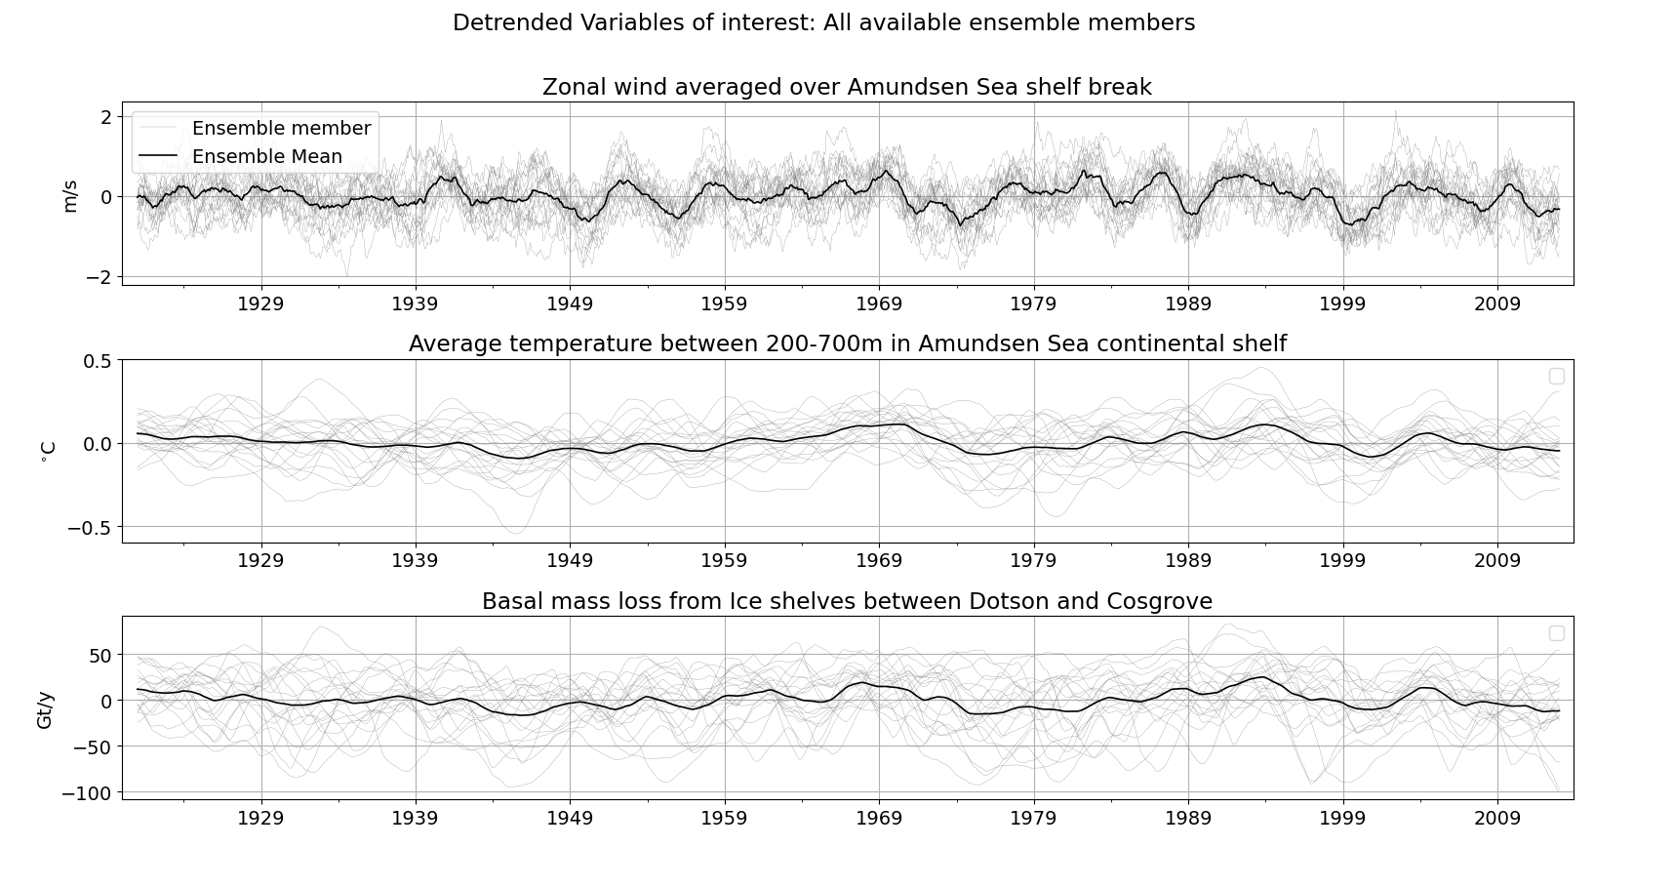
Not a lot happening in the ensemble mean…

Slide 5
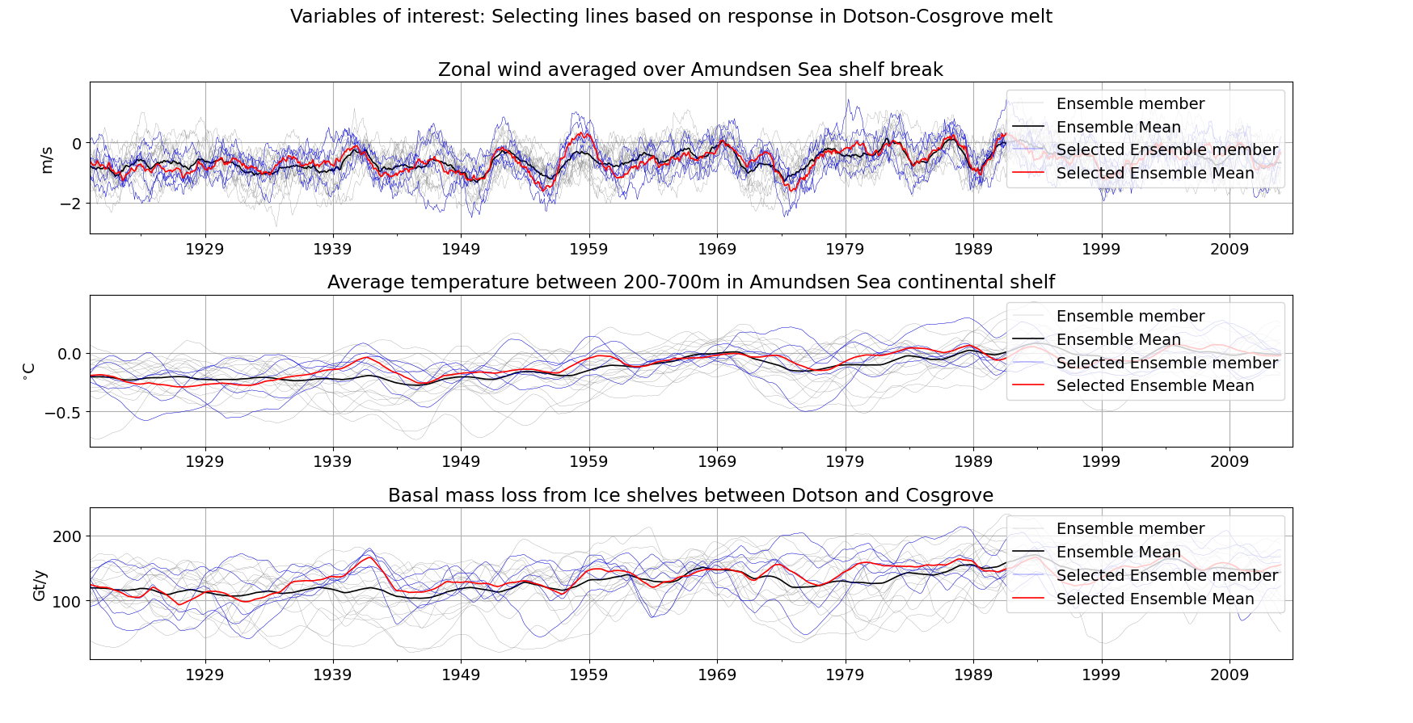
Are there ensemble members that show a strong increase in melting in the 1940s?

Slide 6
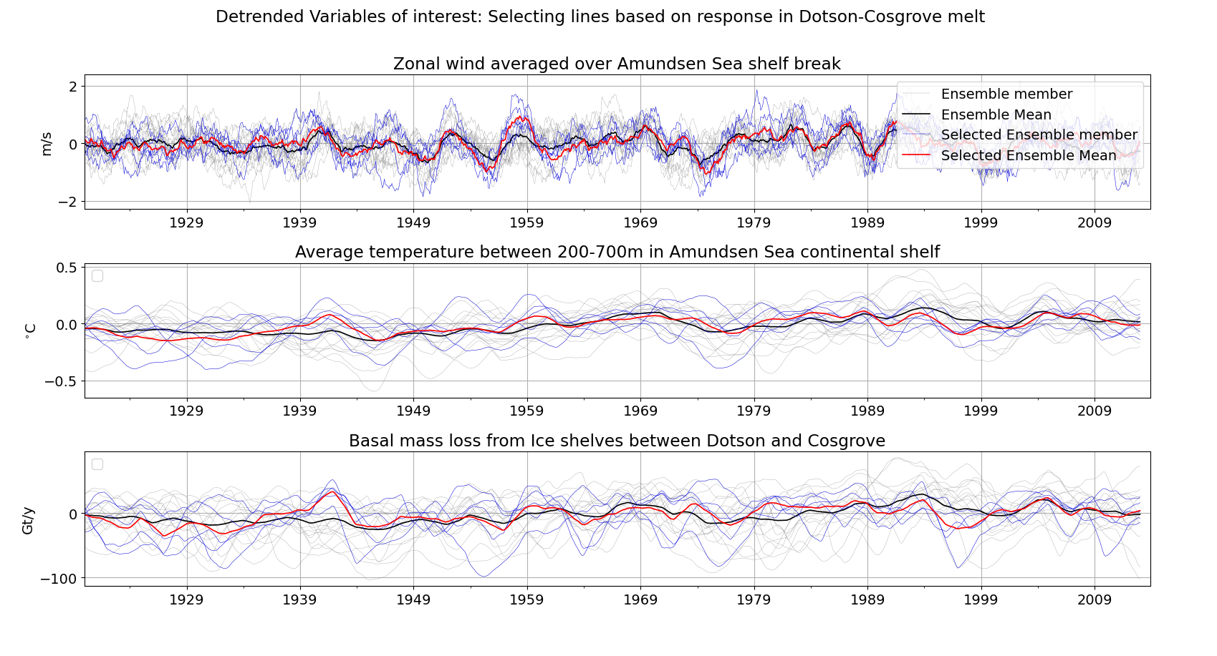

Slide 7
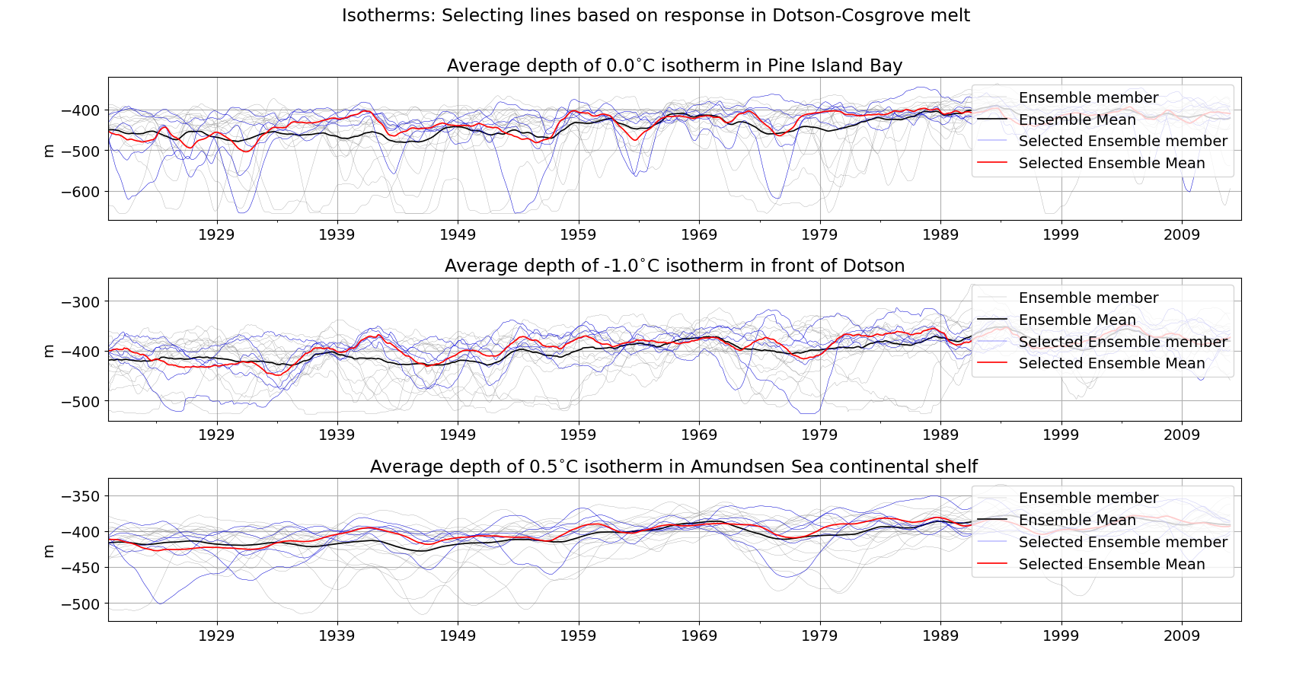
What do they have in common?

Slide 8
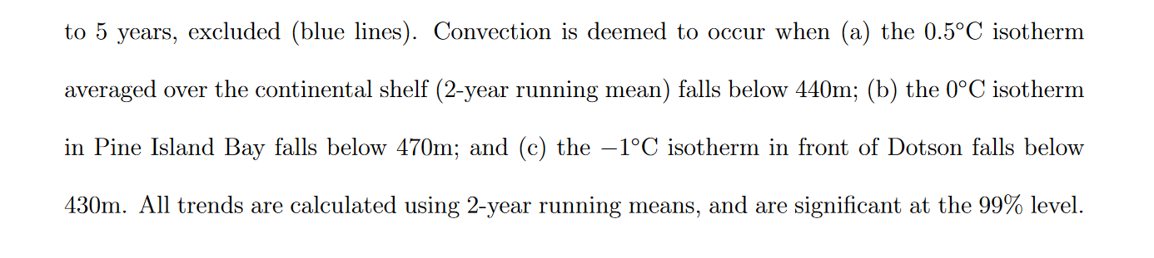
Naughten (concept) Supporting information

Slide 9
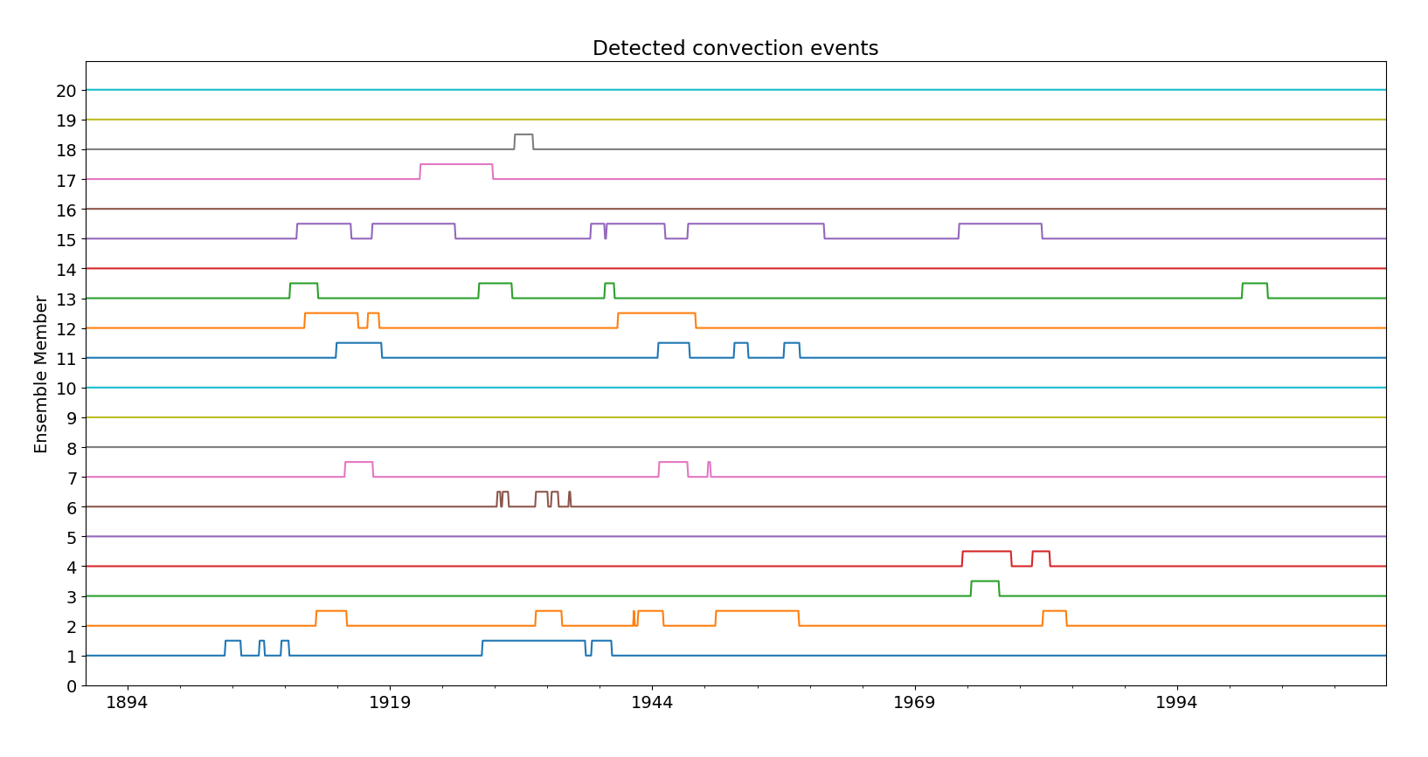

Slide 10
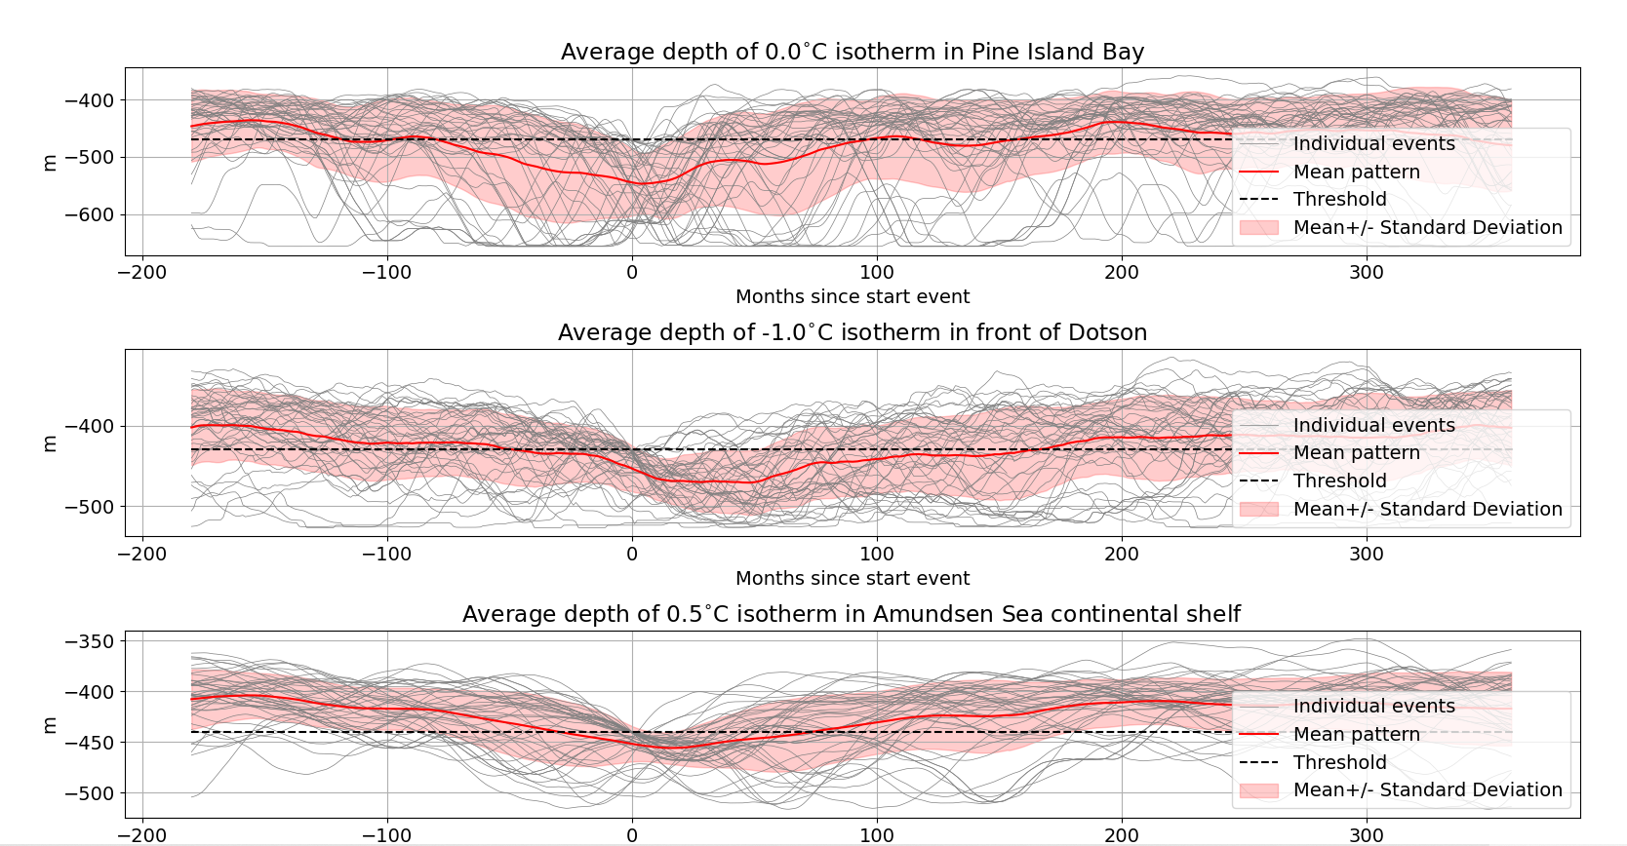
The characteristics of an average convection event
Pine Island Bay isotherm mean remains below threshold for a long time
Hardly any event follows mean path, but “periods of instability”

Slide 11
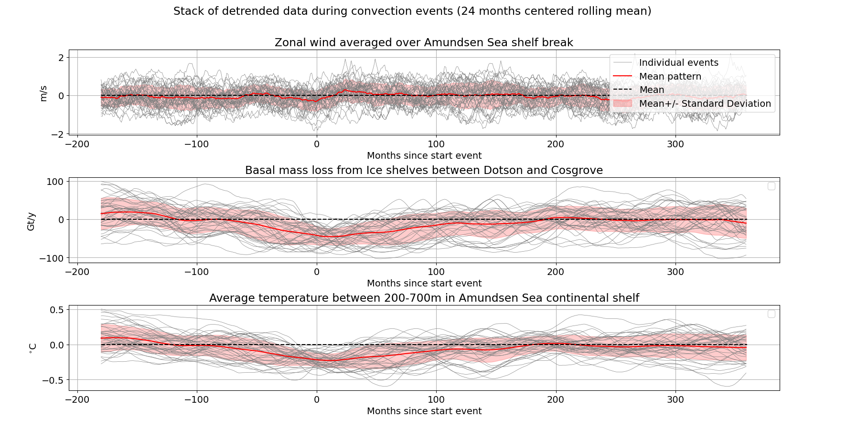

Slide 12
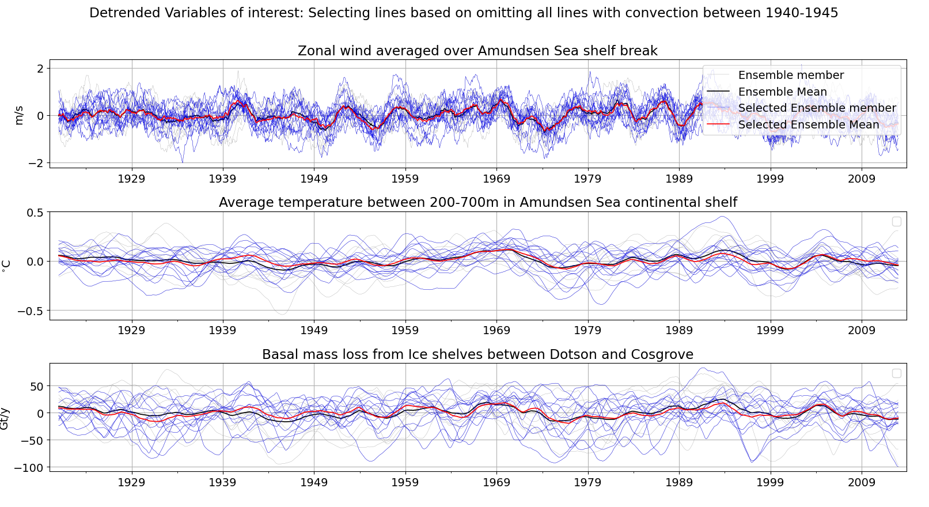
1940 peak: About 11 Gt/y max anomaly

Slide 13
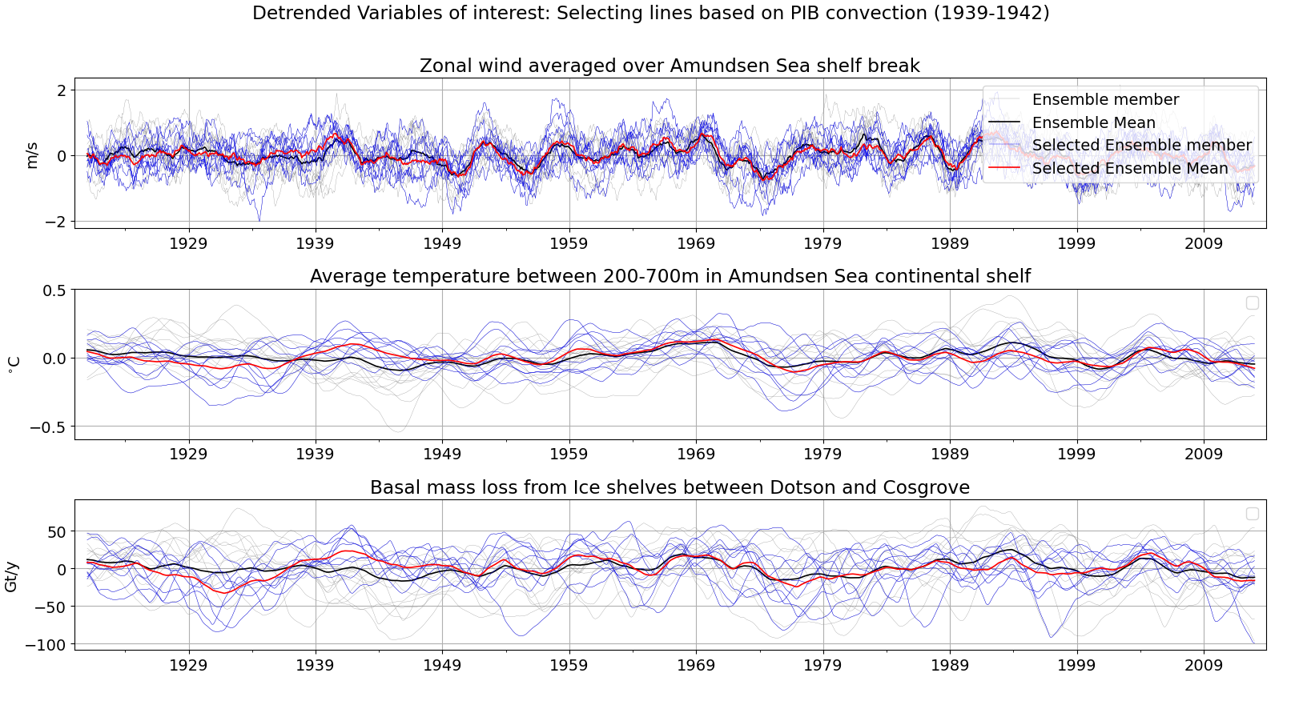
1940 peak: About 23 Gt/y max anomaly

Slide 14
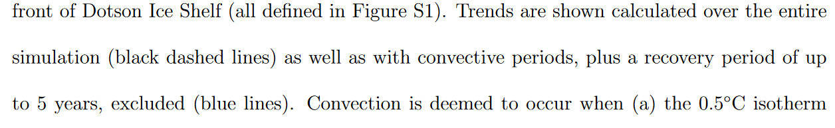
Naughten (concept) Supporting information

Slide 15
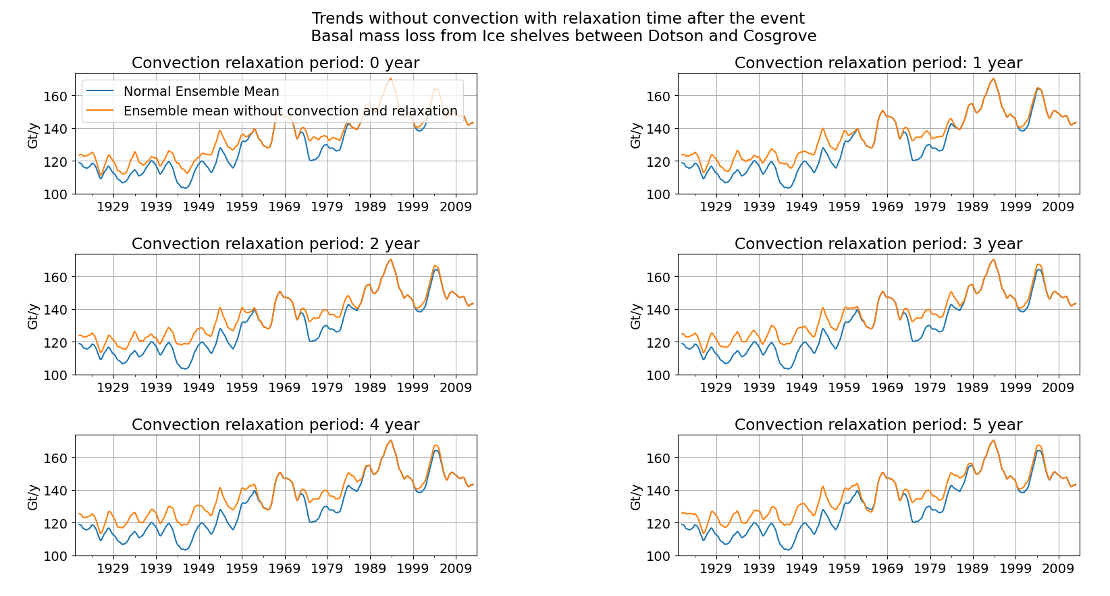

Slide 16
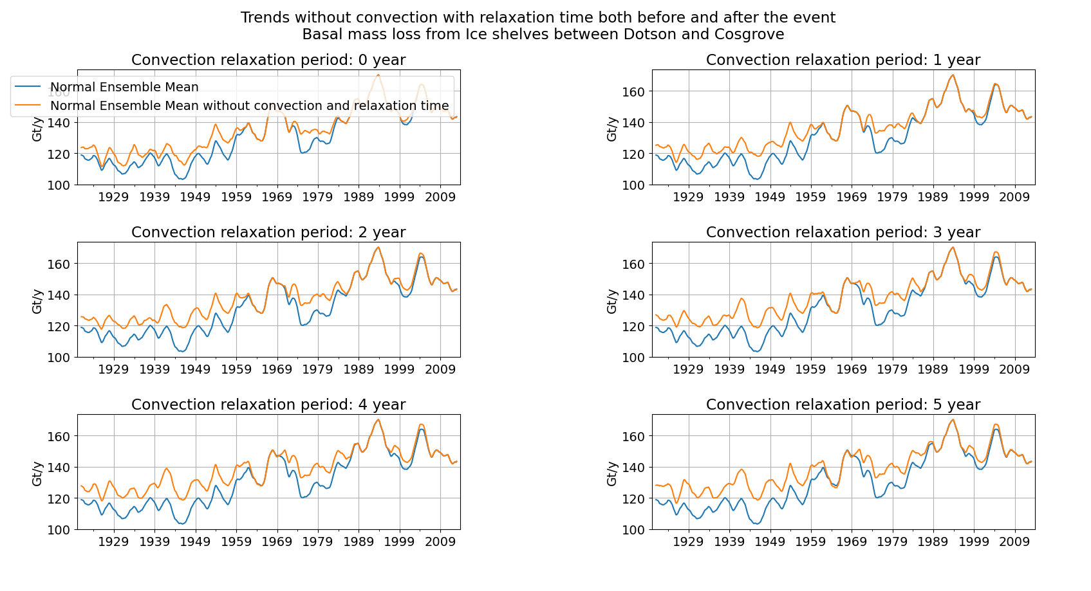

Slide 17
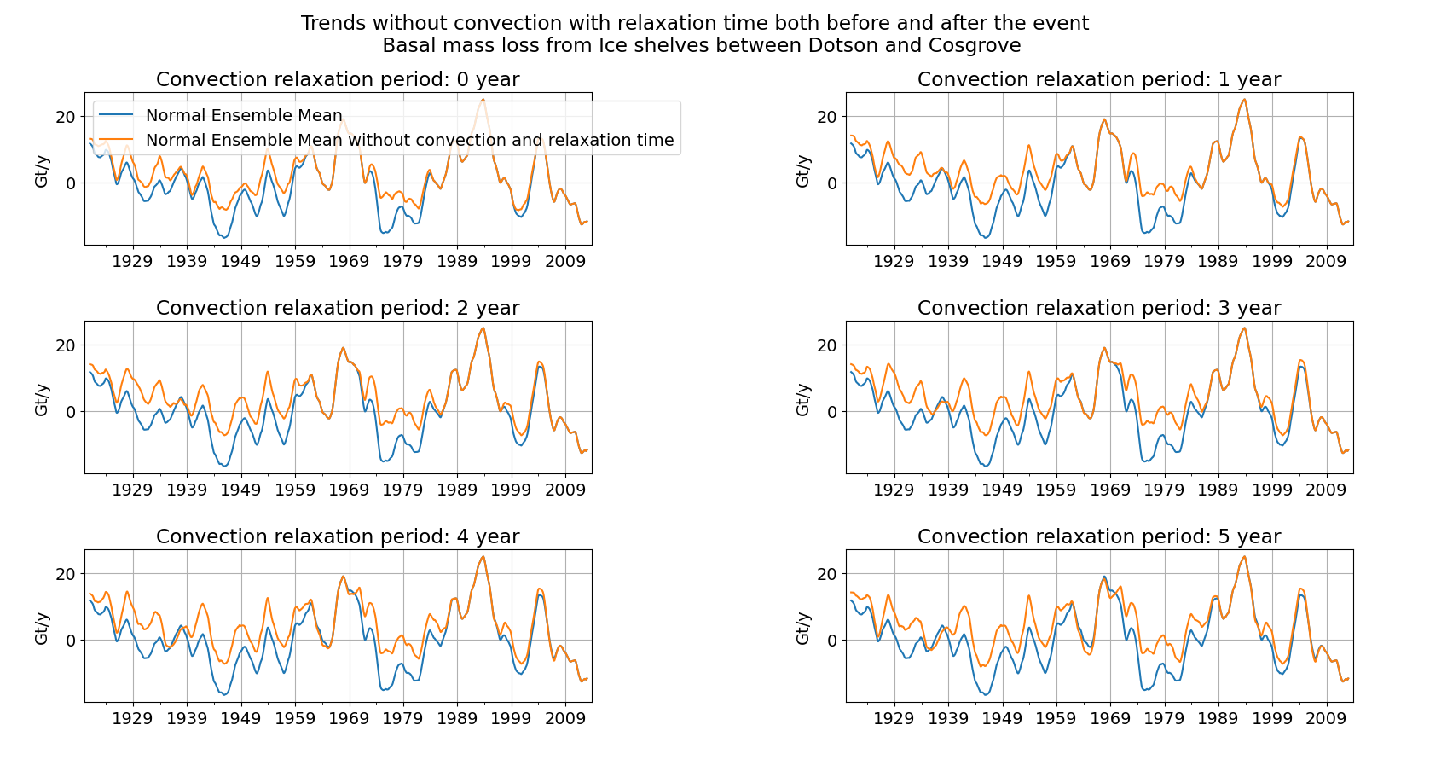

Slide 18
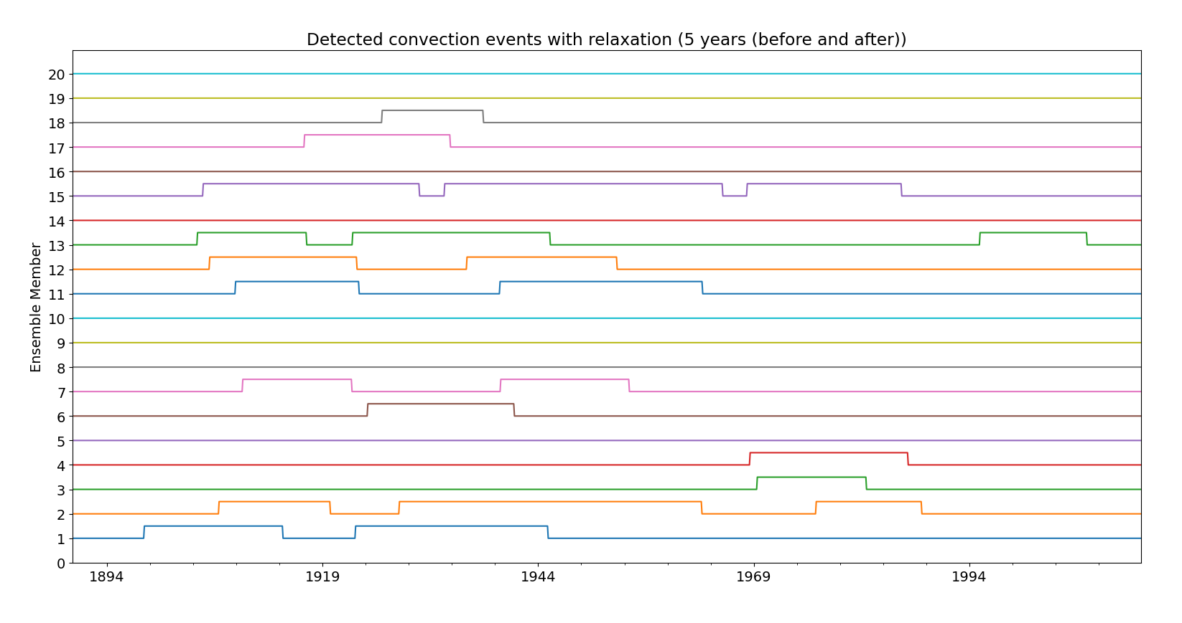

Slide 19
Conclusion
Mean does not show a strong melting anomaly.
Some ensemble members seem to show a melting anomaly.
The presence of the anomaly seems to depend on the presence of convection.
Melting seems to be especially sensitive to PIB convection.
Sensitive to time before the convection event is detected.
The anomaly, even if present, is not extremely large.

Slide 20
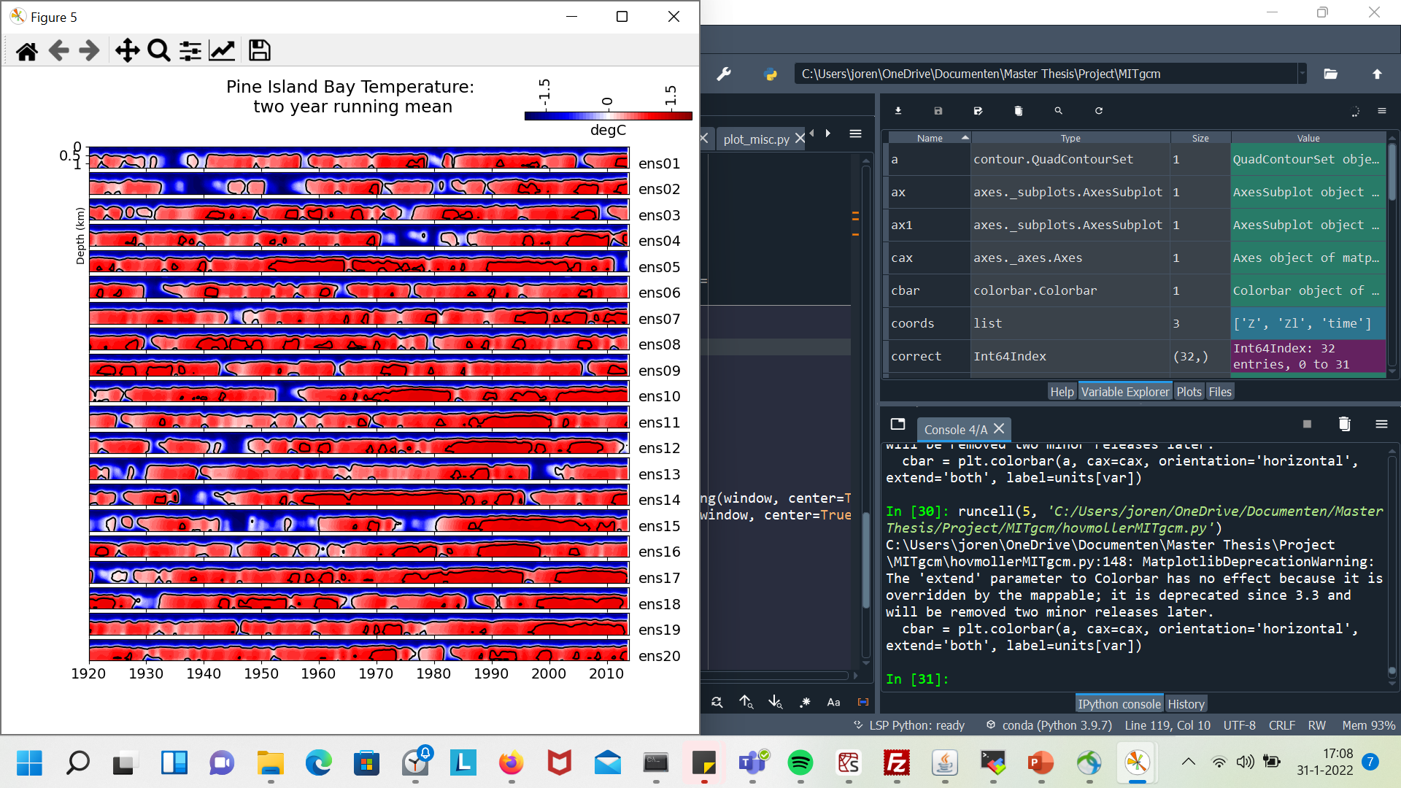
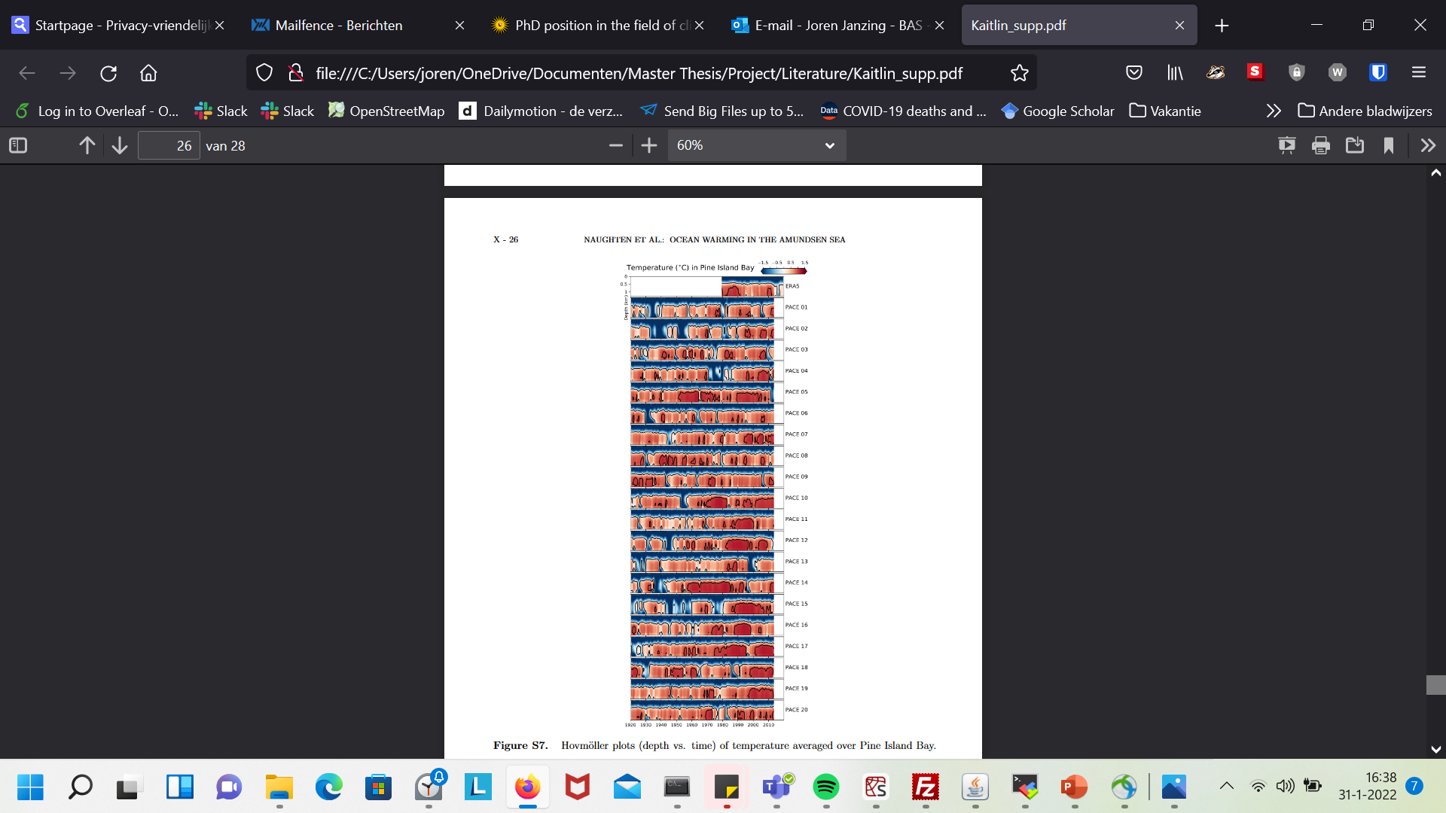
one

Slide 21
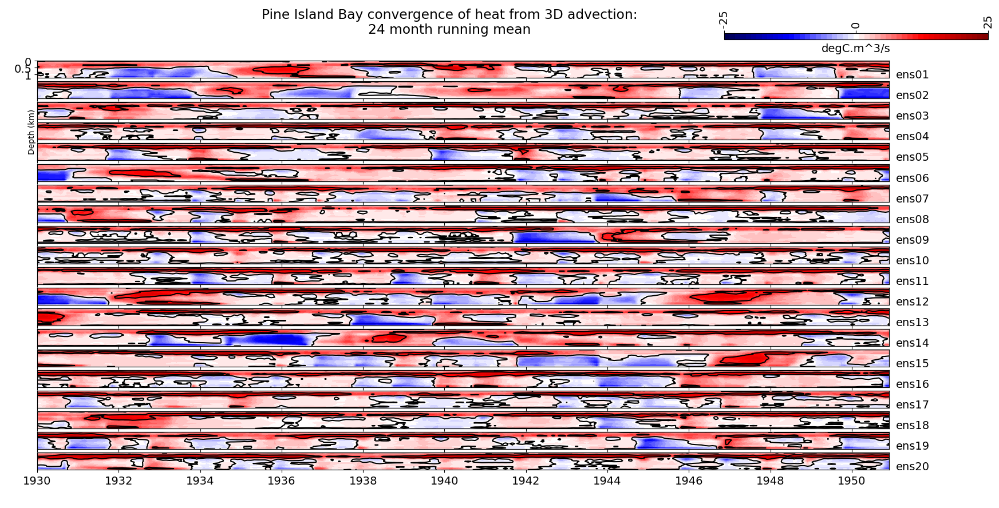

Slide 22
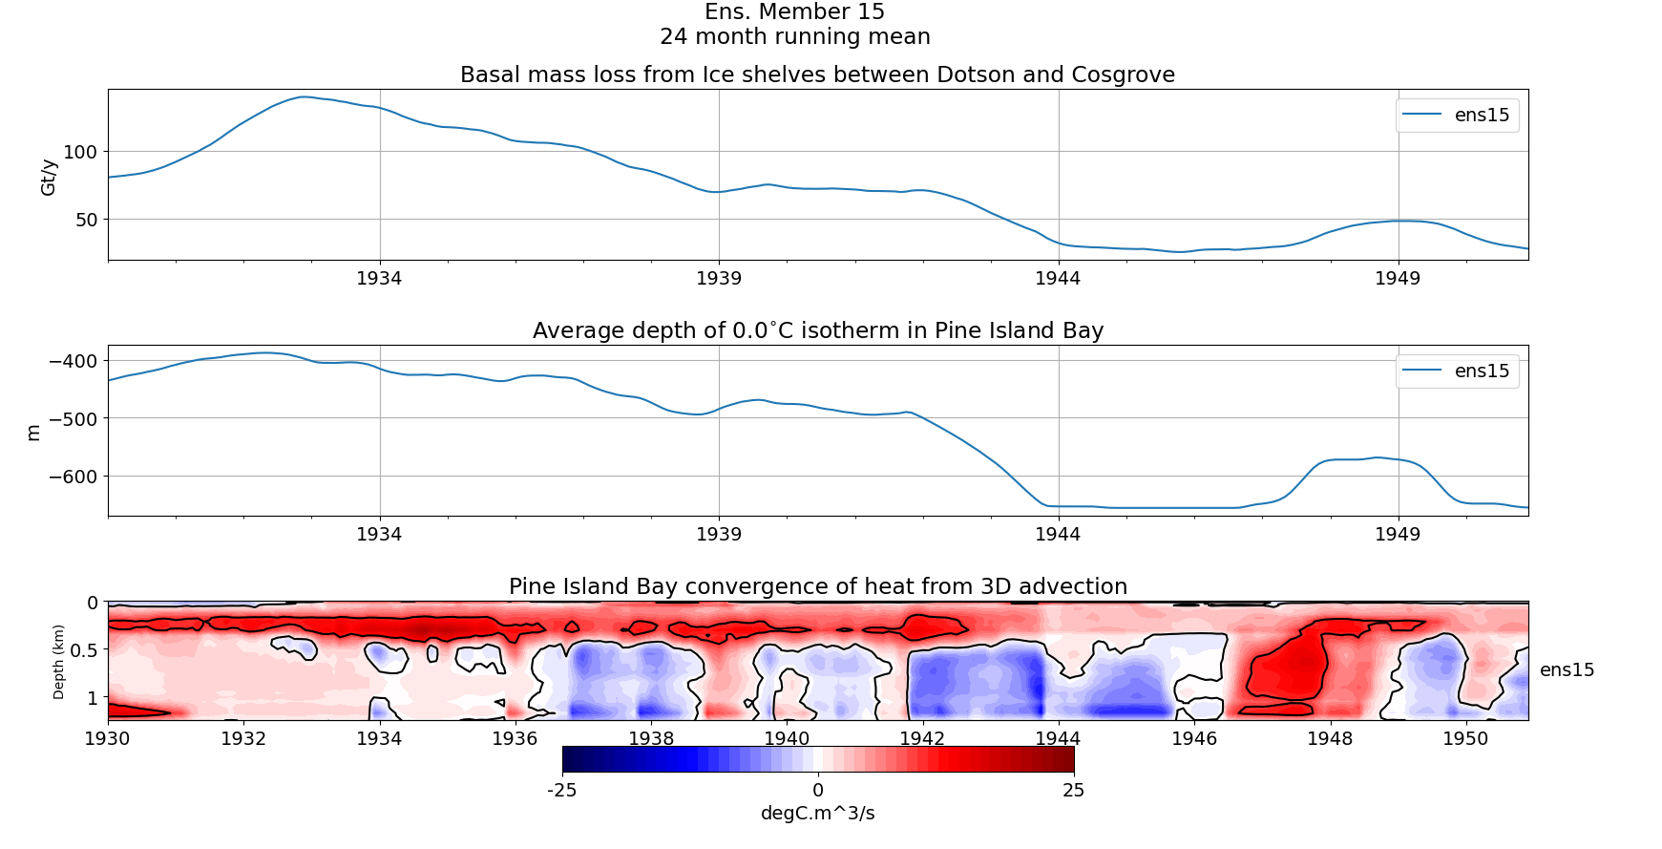

Slide 23
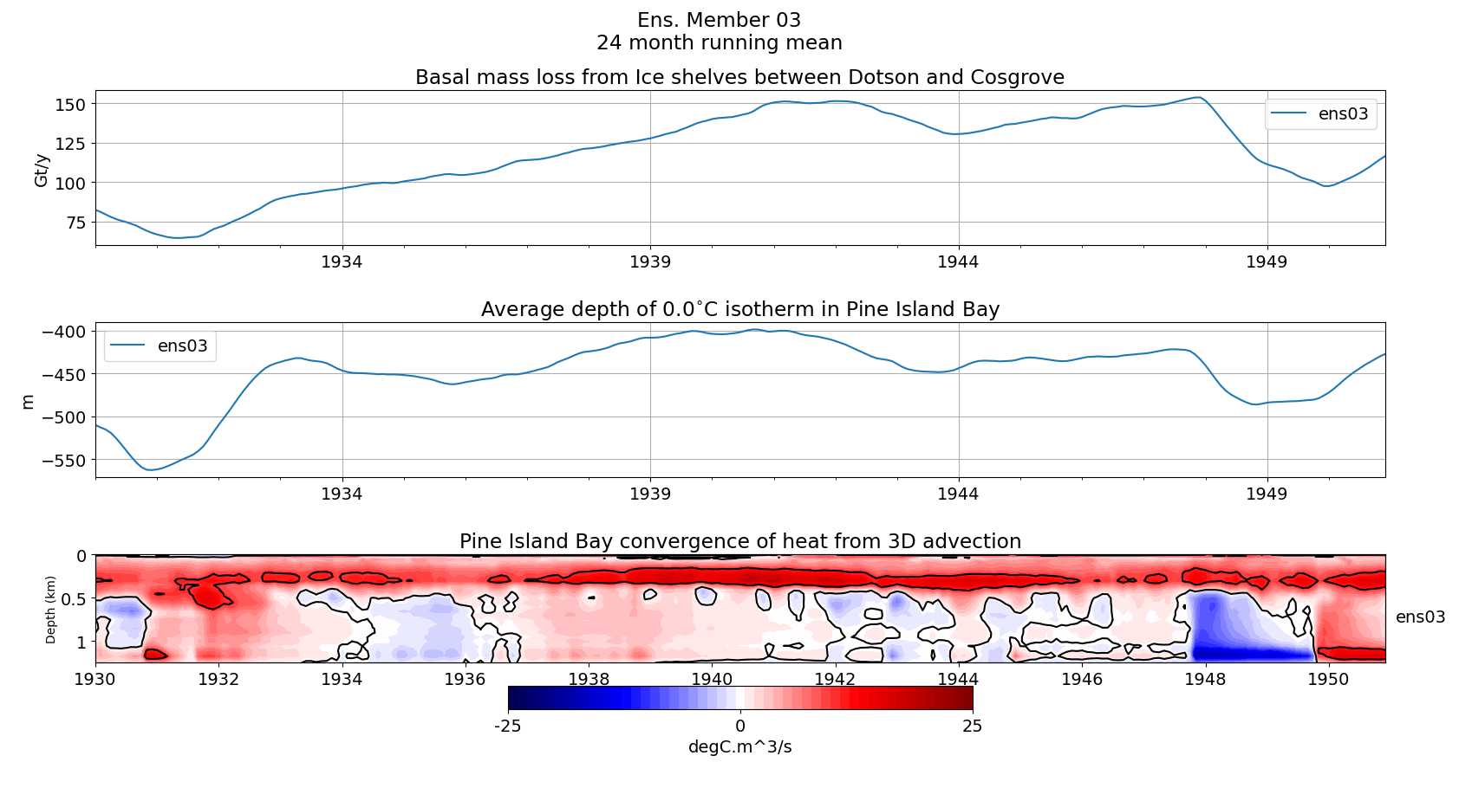

Slide 24
Next steps
Writing is lagging behind a bit
Deviations from mean hovmoller
Maps: anomalous spatial conditions?
Question:
mitgcm_utils
Organising:
Meeting with Paul etc
Travel to Cambridge

Slide 25
How strong is the influence of the winds on a 5 year time scale?
Spatial correlations of mid-depth temperatures/thermocline depth with shelf break winds.
Winds anywhere with temperature on the shelf?→ maybe different region!

Slide 26
Extra old dias

Slide 27
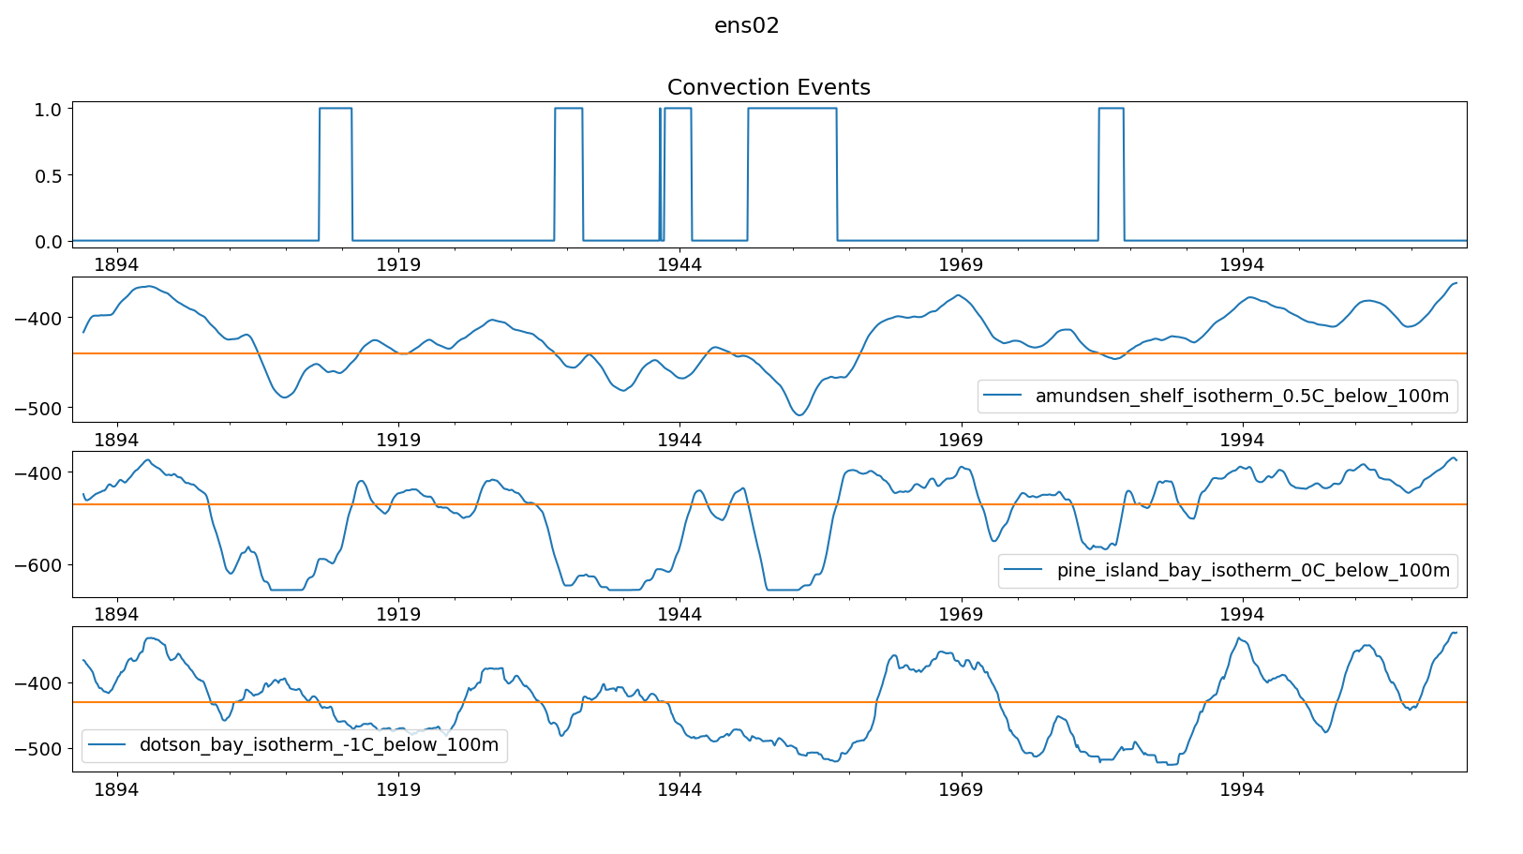

Slide 28
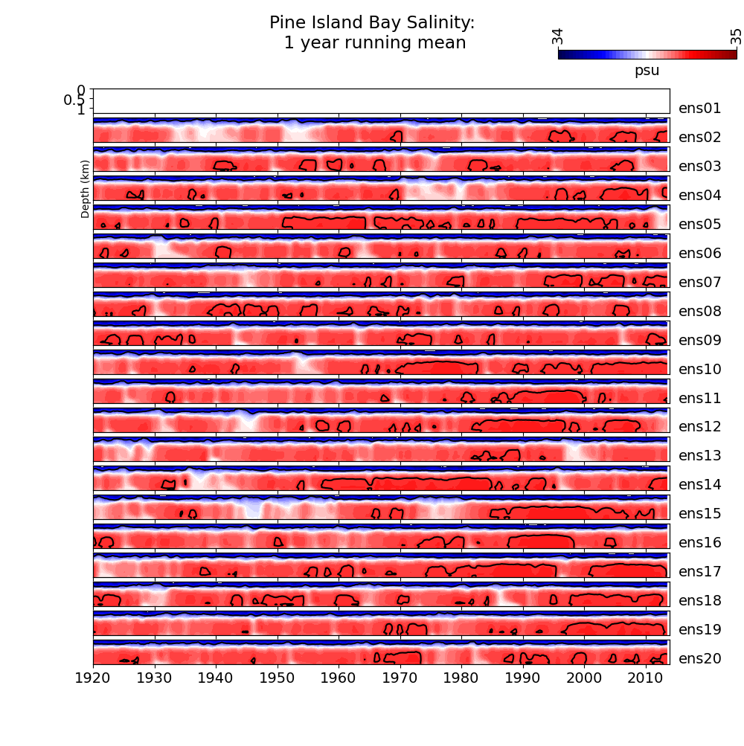

Slide 29
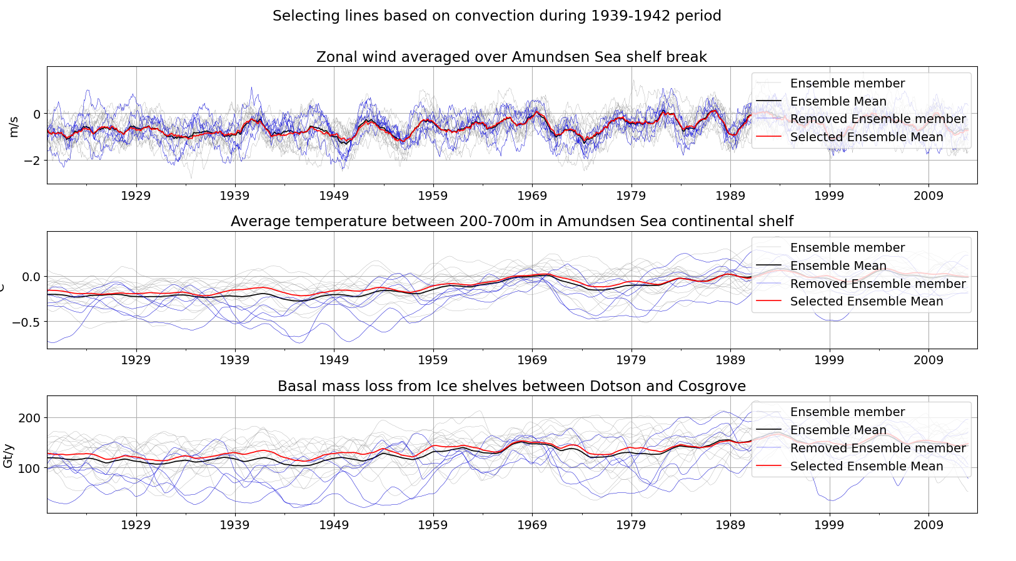

Slide 30
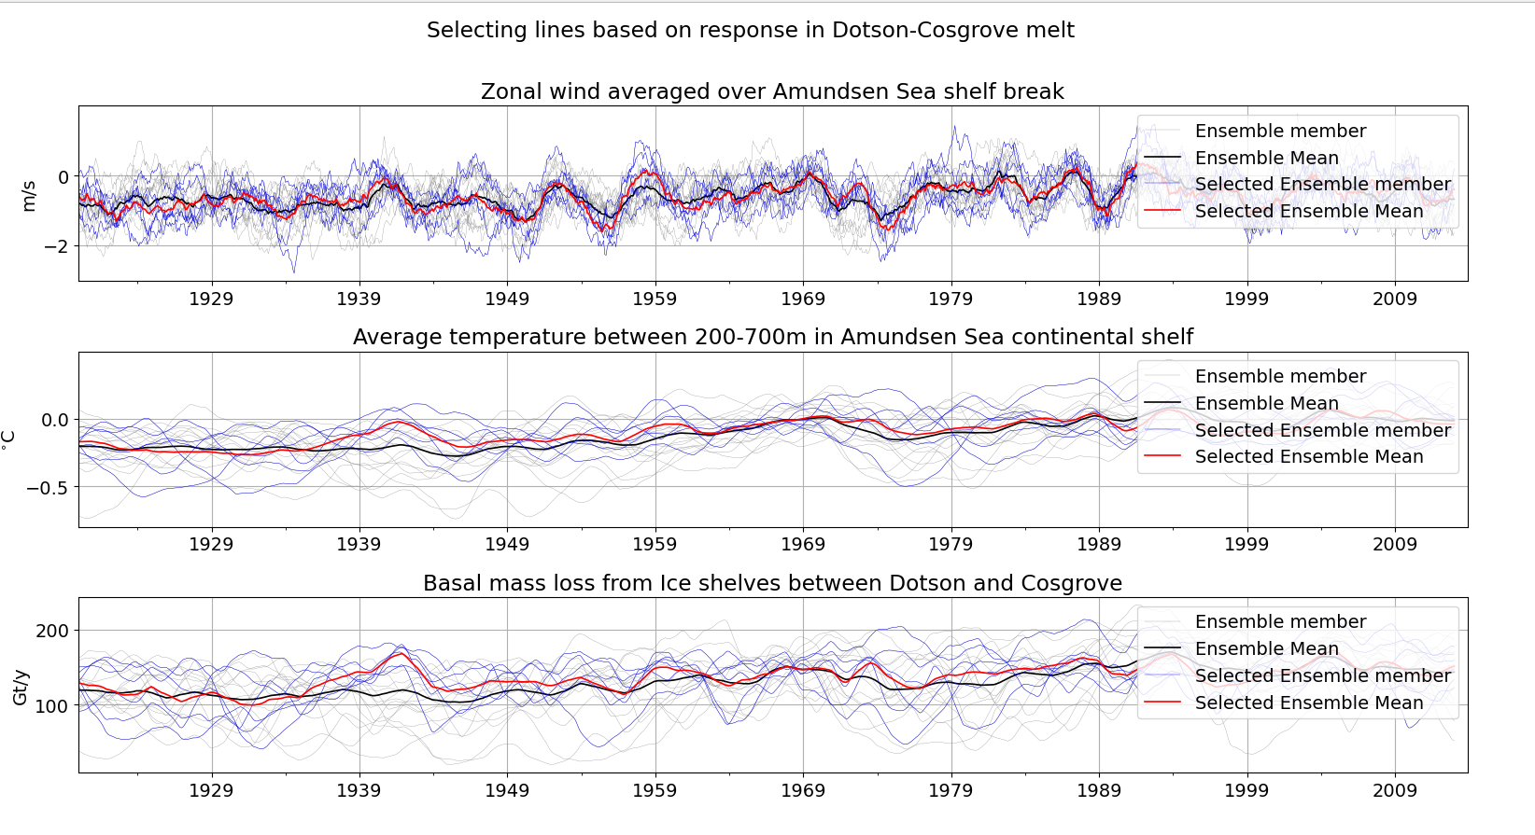

Slide 31
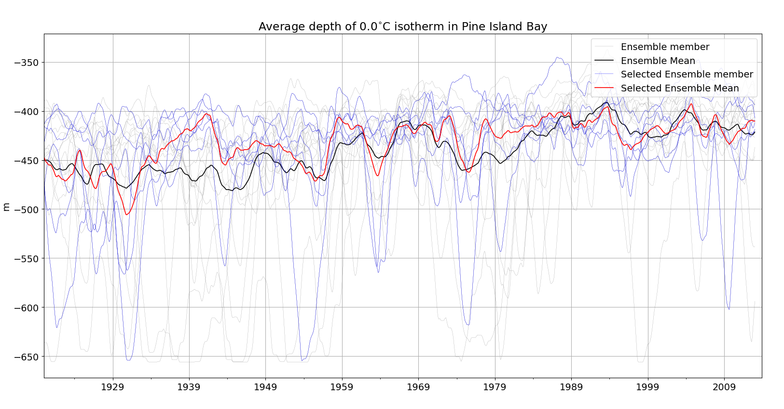

Slide 32
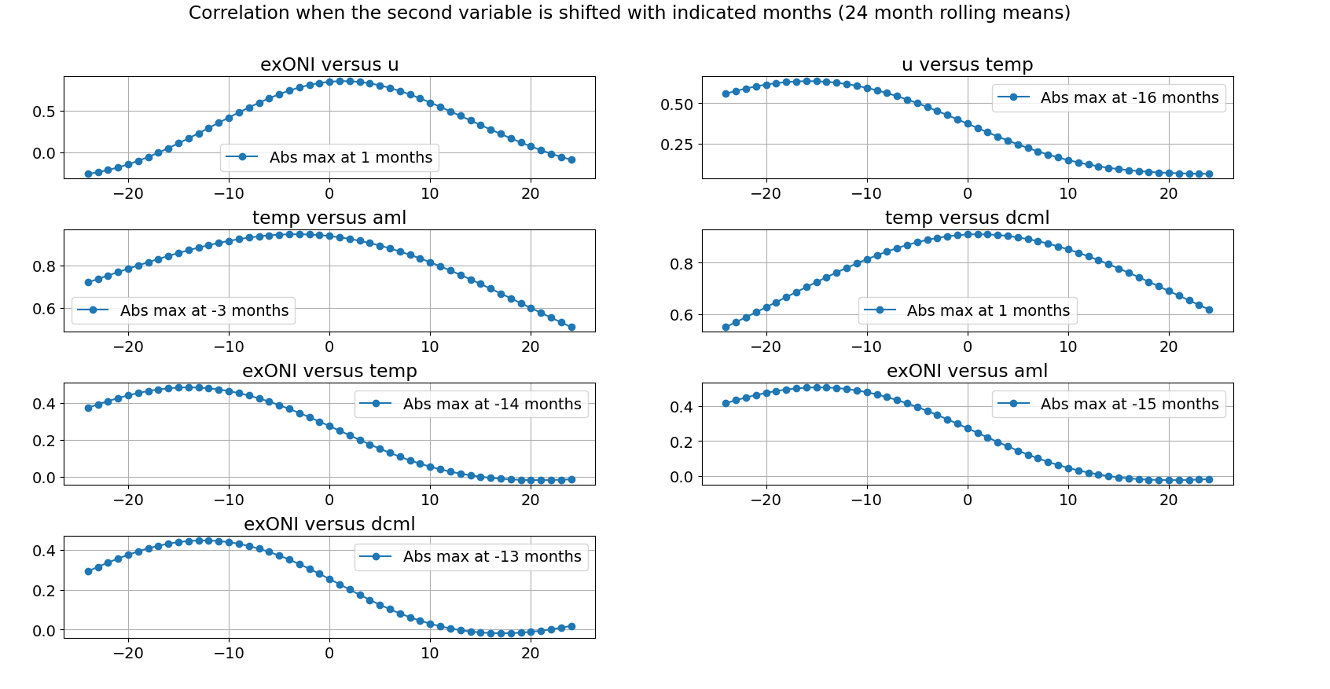
Correlation between different Variables: Lag!

